Slide 1
Parallel and Distributed Computing
Lecture – 01 Introduction

Slide 2
Background – Serial Computing
Computer software was written conventionally for serial computing.
Standard computing is also known as "serial computing"
This meant that to solve a problem, an algorithm divides the problem into smaller instructions.
These discrete instructions are then executed on the Central Processing Unit of a computer one by one.
Only after one instruction is finished, next one starts.

Slide 3
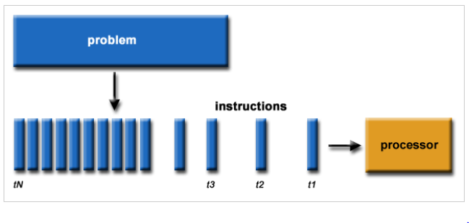
Background – Serial Computing

Slide 4
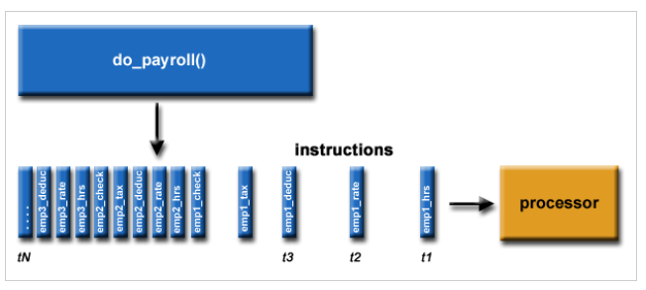
Background – Serial Computing

Slide 5
Background – Serial Computing
A real-life example of this would be people standing in a queue waiting for a movie ticket and there is only a cashier. The cashier is giving tickets one by one to the persons. The complexity of this situation increases when there are 2 queues and only one cashier.
So, in short, Serial Computing is following:
In this, a problem statement is broken into discrete instructions.
Then the instructions are executed one by one.
Only one instruction is executed at any moment of time.

Slide 6
Background – Serial Computing
Look at point 3. This was causing a huge problem in the computing industry as only one instruction was getting executed at any moment of time. This was a huge waste of hardware resources as only one part of the hardware will be running for particular instruction and of time.
As problem statements were getting heavier and bulkier, so does the amount of time in execution of those statements. Examples of processors are Pentium 3 and Pentium 4.
Now let’s come back to our real-life problem. We could definitely say that complexity will decrease when there are 2 queues and 2 cashiers giving tickets to 2 persons simultaneously. This is an example of Parallel Computing.

Slide 7
Parallel Computer
Virtually all stand-alone computers today are parallel from a hardware perspective:
- Multiple functional units (L1 cache, L2 cache, branch, prefetch, decode,
floating-point, graphics processing (GPU), integer, etc.)
Multiple execution units/cores
Multiple hardware threads

Slide 8
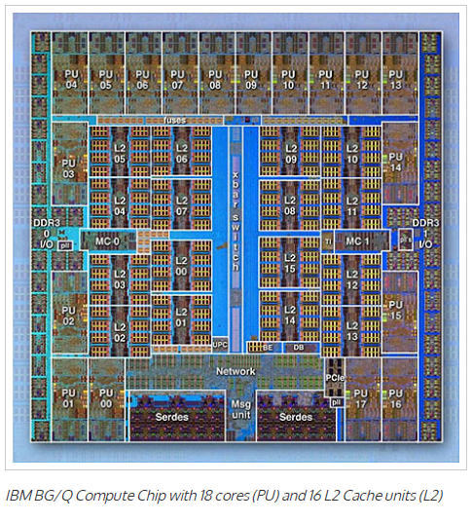
Parallel Computer

Slide 9
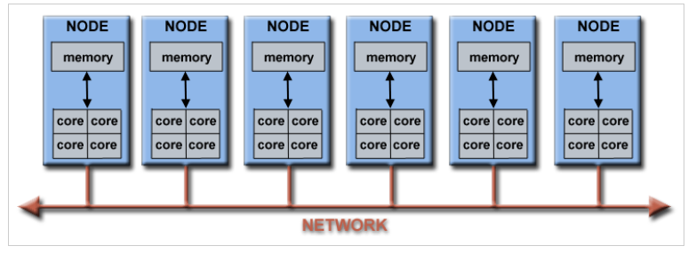
Parallel Computer
Networks connect multiple stand-alone computers (nodes) to make larger parallel computer clusters.

Slide 10
Parallel Computing
Kind of computing architecture where the large problems break into independent, smaller, usually similar parts that can be processed in one go.
It is done by multiple CPUs communicating via shared memory, which combines results upon completion.
It helps in performing large computations as it divides the large problem between more than one processor.

Slide 11
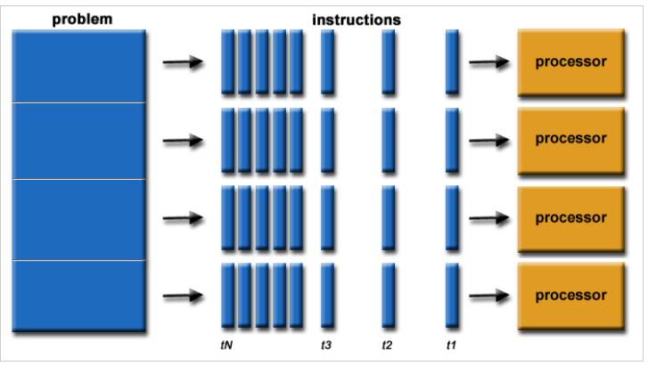
Parallel Computing

Slide 12
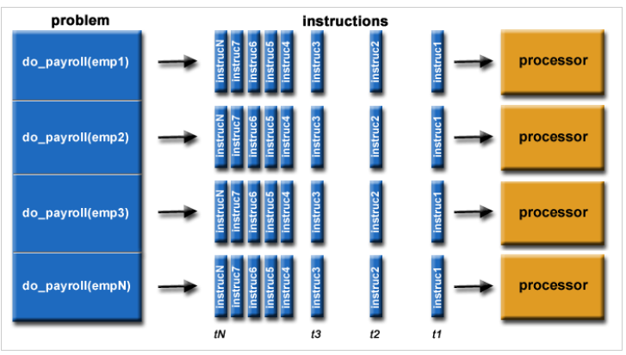
Parallel Computing

Slide 13
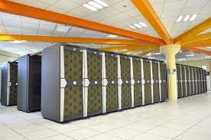
Parallel Computing
Parallel computing also helps in faster application processing and task resolution by increasing the available computation power of systems.
The parallel computing principles are used by most supercomputers employ to operate.
The operational scenarios that need massive processing power or computation, generally, parallel processing is commonly used there.

Slide 14
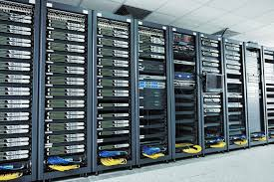
Parallel Computing
Typically, this infrastructure is housed where various processors are installed in a server rack; application server distributes the computational requests into small chunks then requests are processed simultaneously on each server.
The earliest computer software is written for serial computation as they are able to execute a single instruction at one time, but parallel computing is different where it executes several processors an application or computation in one time.

Slide 15
Parallel Computing – Flynn’s Taxonomy
Best known classification scheme for parallel computers.
Depends on parallelism it exhibits with its
- Instruction stream
- Data stream
A sequence of instructions (the instruction stream) manipulates a sequence of operands (the data stream)
The instruction stream (I) and the data stream (D) can be either single (S) or multiple (M)

Slide 16
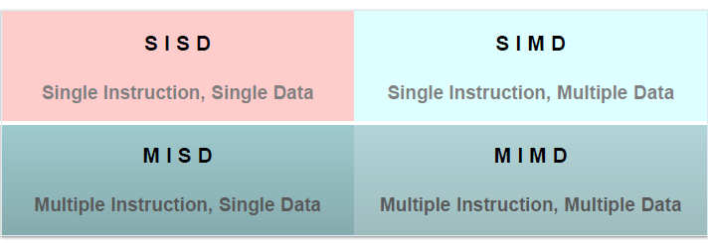
Parallel Computing – Flynn’s Taxonomy
Four combinations: SISD, SIMD, MISD, MIMD

Slide 17
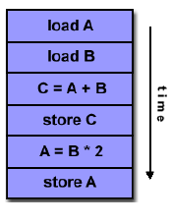
Parallel Computing – Flynn’s Taxonomy
Serial Computer
Single-CPU systems
i.e., uniprocessors
Note: co-processors don’t count as more processors
Examples: older generation main frames, work stations, PCs

Slide 18
Parallel Computing – Flynn’s Taxonomy
A type of parallel computer
All processing units execute the same instruction at any given clock cycle
Each processing unit can operate on a different data element
One instruction stream is broadcast to all processors
Each processor (also called a processing element or PE) is very simplistic and is essentially an ALU;
- PEs do not store a copy of the program nor have a program control unit

Slide 19
Parallel Computing – Flynn’s Taxonomy
All active processor executes the same instruction synchronously, but on different data
On a memory access, all active processors must access the same location in their local memory.
The data items form an array and an instruction can act on the complete array in one cycle.

Slide 20
Parallel Computing – Flynn’s Taxonomy
How to View an SIMD Machine
Think of soldiers all in a unit.
A commander selects certain soldiers as active – for example, every even numbered row.
The commander barks out an order that all the active soldiers should do and they execute the order synchronously.

Slide 21
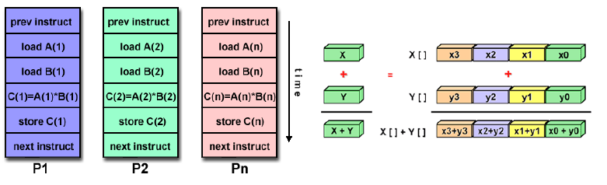
Parallel Computing – Flynn’s Taxonomy
Most modern computers, particularly those with graphics processor units (GPUs) employ SIMD instructions and execution units.

Slide 22
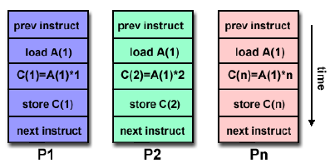
Parallel Computing – Flynn’s Taxonomy
A single data stream is fed into multiple processing units.
Each processing unit operates on the data independently via independent instruction streams.
Few actual examples : Carnegie-Mellon C.mmp computer (1971).

Slide 23
Parallel Computing – Flynn’s Taxonomy
Processors are asynchronous, since they can independently execute different programs on different data sets.
Communications are handled either by
through shared memory. (multiprocessors)
use of message passing (multicomputers)
MIMD’s have been considered by most researchers to include the most powerful, least restricted computers.

Slide 24
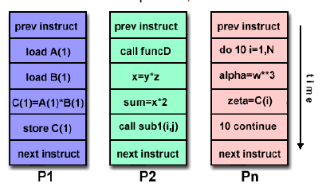
Parallel Computing – Flynn’s Taxonomy
Currently, most common type of parallel computer
Every processor may be executing a different instruction stream
Every processor may be working with a different data stream
Execution can be synchronous or asynchronous, deterministic or non-deterministic

Slide 25
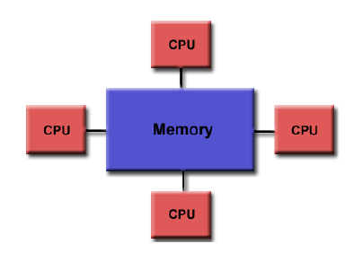
Parallel Computing –Parallel Computer Architectures
Shared memory: all processors can access the same memory
Uniform memory access (UMA):
identical processors
equal access and access times to memory

Slide 26
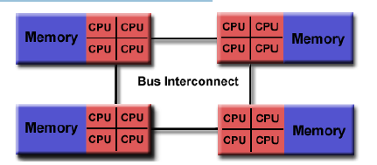
Parallel Computing –Non-uniform memory access (NUMA)
Not all processors have equal access to all memories
Memory access across link is slower
Advantages: -user-friendly programming perspective to memory -fast and uniform data sharing due to the proximity of memory to CPUs
Disadvantages: -lack of scalability between memory and CPUs. -Programmer responsible to ensure "correct" access of global memory -Expense

Slide 27
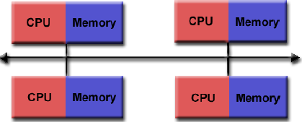
Parallel Computing - Distributed Memory
Distributed memory systems require a communication network to connect inter-processor memory.
Advantages: -Memory is scalable with number of processors. -No memory interference or overhead for trying to keep cache coherency. -Cost effective
Disadvantages: -programmer responsible for data communication between processors. -difficult to map existing data structures to this memory organization.

Slide 28
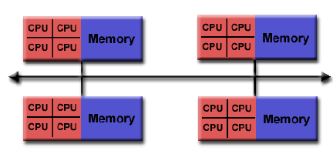
Parallel Computing - Hybrid Distributed-Shared Memory
Generally used for the currently largest and fastest computers
Has a mixture of previously mentioned advantages and disadvantages

Slide 29
Parallel Computing - Advantages
It saves time and money as many resources working together will reduce the time and cut potential costs.
It can be impractical to solve larger problems on Serial Computing
It can take advantage of non-local resources when the local resources are finite.
Reduces the Complexity
Serial Computing ‘wastes’ the potential computing power, thus Parallel Computing makes better work of the hardware.

Slide 30
Parallel Computing – Parallel Programming
Parallel programming (also, unfortunately, sometimes called concurrent programming), is a computer programming technique that provides for the execution of operations concurrently, either
- within a single parallel computer OR
- across a number of systems.
In the latter case, the term distributed computing is used.

Slide 31
Parallel Computing – Parallel Programming Model
Shared Model
tasks share a common address space, which they read and write asynchronously.
Various mechanisms such as locks / semaphores may be used to control access to the shared memory.
Advantage:
no need to explicitly communicate of data between tasks -> simplified programming
Disadvantages:
Need to take care when managing memory, avoid synchronization conflicts
Harder to control data locality

Slide 32
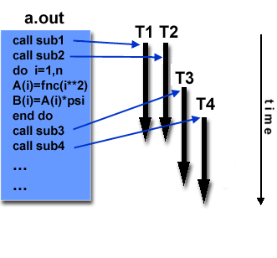
Parallel Computing – Parallel Programming Model
Threads
A thread can be considered as a subroutine in the main program
Threads communicate with each other through the global memory
commonly associated with shared memory architectures and operating systems
PosixThreads or pthreads
OpenMP

Slide 33
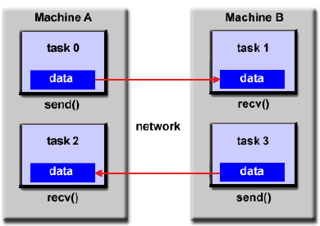
Parallel Computing – Parallel Programming Model
Message Passing
A set of tasks that use their own local memory during computation.
Data exchange through sending and receiving messages.
Data transfer usually requires cooperative operations to be performed by each process. For example, a send operation must have a matching receive operation.
MPI (released in 1994)
MPI-2 (released in 1996)

Slide 34
Parallel Computing – Parallel Programming Model
Data Parallel Model
The data parallel model demonstrates the following characteristics:
Most of the parallel work performs operations on a data set, organized into a common structure, such as an array
A set of tasks works collectively on the same data structure, with each task working on a different partition
Tasks perform the same operation on their partition
On shared memory architectures, all tasks may have access to the data structure through global memory. On distributed memory architectures the data structure is split up and resides as "chunks" in the local memory of each task.

Slide 35
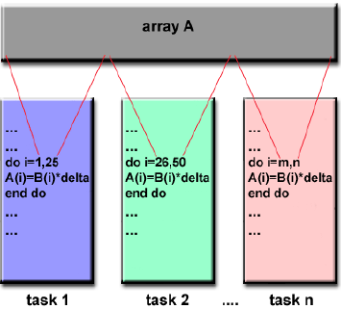
Parallel Computing – Parallel Programming Model
Data Parallel Model

Slide 36
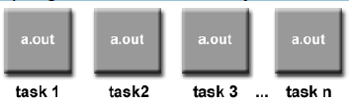
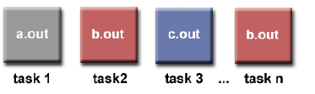
Parallel Computing – Parallel Programming Model
Hybrid
combines various models, e.g. MPI/OpenMP
Single Program Multiple Data (SPMD)
A single program is executed by all tasks simultaneously
Multiple Program Multiple Data (MPMD)
An MPMD application has multiple executables. Each task can execute the same or different program as other tasks.

Slide 37
Parallel Computing – Types
Bit-level parallelism
Instruction-level parallelism
Task Parallelism

Slide 38
Parallel Computing – Types
Bit-level parallelism
Every task is dependent on processor word size. In terms of performing a task on large-sized data, it reduces the number of instructions the processor must execute.
There is a need to split the operation into series of instructions. For example, there is an 8-bit processor, and you want to do an operation on 16-bit numbers. First, it must operate the 8 lower-order bits and then the 8 higher-order bits. Therefore, two instructions are needed to execute the operation. The operation can be performed with one instruction by a 16-bit processor.

Slide 39
Parallel Computing – Types
Instruction-level parallelism
A processor can only address less than one instruction for each clock cycle phase. These instructions can be re-ordered and grouped which are later on executed concurrently without affecting the result of the program. This is called instruction-level parallelism

Slide 40
Parallel Computing – Limitations
It addresses such as communication and synchronization between multiple sub-tasks and processes which is difficult to achieve.
The algorithms must be managed in such a way that they can be handled in a parallel mechanism.
The algorithms or programs must have low coupling and high cohesion. But it’s difficult to create such programs.
More technically skilled and expert programmers can code a parallelism-based program well.

Slide 41
von Neumann Computer
Model for designing and building computers, based on the following three characteristics:
The computer consists of four main sub-systems:
Memory
ALU (Arithmetic/Logic Unit)
Control Unit
Input/Output System (I/O)
Program is stored in memory during execution.
Program instructions are executed sequentially.

Slide 42
von Neumann Computer
Bus
Memory
Processor (CPU)
Input-Output
Control Unit
ALU
Communicate with
"outside world", e.g.
Screen
Keyboard
Storage devices
...
Store data and program
Execute program
Do arithmetic/logic operations requested by program

Slide 43


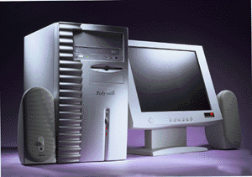
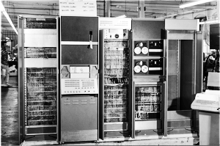
von Neumann Computer
All computers more or less based on the same basic design, the Von Neumann Architecture!

Slide 44
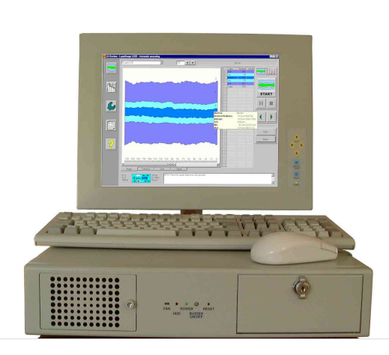
Personnel Computer

Slide 45
Motivations for Parallel Computing
Fundamental limits on single processor speed
Heat dissipation from CPU chips
Disparity between CPU & memory speeds
Distributed data communications
Need for very large scale computing platforms

Slide 46
Motivations for Parallel Computing
Fundamental limits – Cycle Speed
- Intel 8080 2MHz 1974
ARM 2 8MHz 1986
Intel Pentium Pro 200MHz 1996
AMD Athlon 1.2GHz 2000
Intel QX6700 2.66GHz 2006
Intel Core i7 3770k 3.9GHz 2013
Speed of light: 30cm in 1ns

Slide 47
Moore’s Law
Moore’s observation in 1965: the number of transistors per square inch on integrated circuits had doubled every year since the integrated circuit was invented
Moore’s revised observation in 1975: the pace was slowed down a bit, but data density had doubled approximately every 18 months
How about the future? (price of computing power falls by a half every 18 months?)

Slide 48
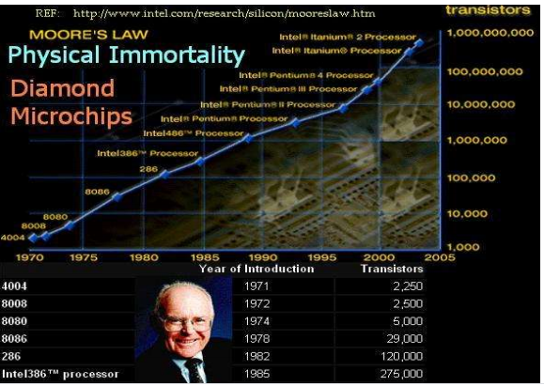
Moore’s Law – Held for Now

Slide 49
Power Wall Effect in Computer Architecture
Too many transistors in a given chip die area
Tremendous increase in power density
Increased chip temperature
High temperature slows down the transistor switching rate and the overall speed of the computer
Chip may melt down if not cooled properly  Efficient cooling systems are expensive

Slide 50
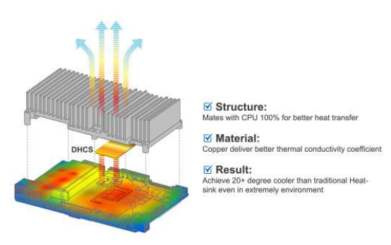
Cooling Computer Chips
Some people suggest to put computer chips in liquid nitrogen to cool them

Slide 51
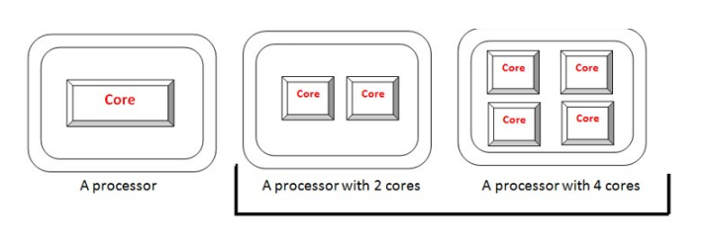
Solutions
Use multiple inexpensive processors A processor with multiple cores

Slide 52
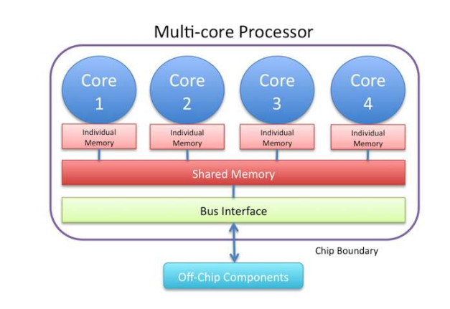
A Multi-Core Processor

Slide 53
CPU and Memory Speed
In 20 years, CPU speed (clock rate) has increased by a factor of 1000
DRAM speed has increased only by a factor of smaller than 4
How to feed data faster enough to keep CPU busy?
CPU speed: 1-2 ns
DRAM speed: 50-60 ns
Cache: 10 ns

Slide 54
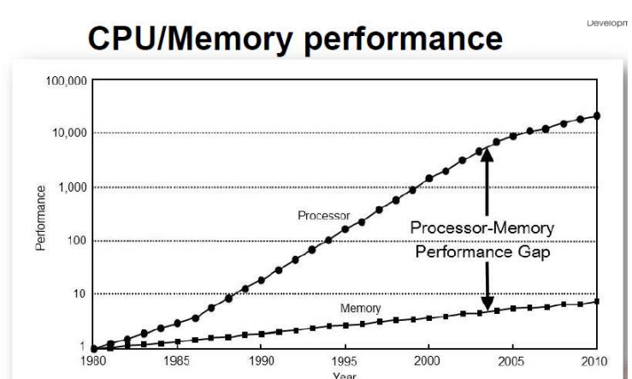
Memory Access and CPU Speed

Slide 55
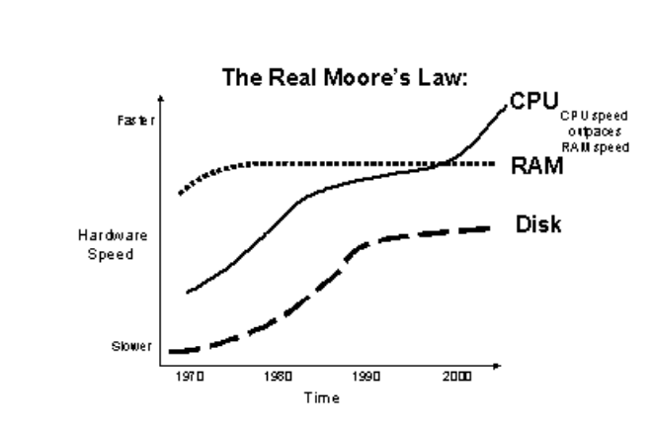
CPU, Memory and Disk Speed

Slide 56
Possible Solutions
A hierarchy of successively fast memory devices (multilevel caches)
Location of data reference (code)
Efficient programming can be an issue
Parallel systems may provide
1.) larger aggregate cache
2.) higher aggregate bandwidth to the memory system

Slide 57
Parallel Computing – Useful Terms
Concurrent - Events or processes which seem to occur or progress at the same time.
Parallel –Events or processes which occur or progress at the same time
Parallel programming (also, unfortunately, sometimes called concurrent programming), is a computer programming technique that provides for the execution of operations concurrently, either
- within a single parallel computer OR
- across a number of systems.
In the latter case, the term distributed computing is used.

Slide 58
Parallel Computing – Useful Terms
All processors have access to all memory locations .
Uniform memory access (UMA)
Similar to uniprocessor, except additional, identical CPU’s are added to the bus.
Each processor has equal access to memory and can do anything that any other processor can do.
Also called a symmetric multiprocessor or SMP
We will discuss in greater detail later (e.g., text pg 43)
SMPs and clusters of SMPs are currently very popular

Slide 59
Parallel Computing – Useful Terms
Coupling and Cohesion
In software engineering, coupling is the degree of interdependence between software modules; a measure of how closely connected two routines or modules are; the strength of the relationships between modules
Coupling is usually contrasted with cohesion. Low coupling often correlates with high cohesion, and vice versa. Low coupling is often thought to be a sign of a well-structured computer system and a good design, and when combined with high cohesion, supports the general goals of high readability and maintainability.

Slide 60
Parallel Computing – Useful Terms
FLOPS
Floating-point operations per second, or FLOPS, is the unit of measurement that calculates the performance capability of a supercomputer.
Floating-point operations can only be executed on computers with integrated floating-point registers.
The average computer’s processor performance is measured by megahertz (MHz) units to calculate its clock speed. Since supercomputers are far more capable when it comes to power performance, the method in which performance is calculated must be on a considerably larger scale

Slide 61
Parallel Computing – Useful Terms
FLOPS
One petaFLOPS is equal to 1,000,000,000,000,000 (one quadrillion) FLOPS, or one thousand teraFLOPS
One teraFLOPS is equal to 1,000,000,000,000 (one trillion) FLOPS.

Slide 62
Parallel Computing – Useful Terms
SETI@home
SETI@home ("SETI at home") is a project of the Berkeley SETI Research Center to analyze radio signals, searching for signs of extraterrestrial intelligence. Until March 2020, it was run as an Internet-based public volunteer computing project that employed the BOINC software platform. It is hosted by the Space Sciences Laboratory at the University of California, Berkeley, and is one of many activities undertaken as part of the worldwide SETI effort.

Slide 63

Parallel Computing – Useful Terms
Extraterrestrial intelligence
Extraterrestrial intelligence (often abbreviated ETI) refers to hypothetical intelligent extraterrestrial life (Extraterrestrial life is hypothetical life that may occur outside Earth and which did not originate on Earth.)

Slide 64
Parallel Computing
Parallel computing also helps in faster application processing and task resolution by increasing the available computation power of systems.
The parallel computing principles are used by most supercomputers employ to operate.
The operational scenarios that need massive processing power or computation, generally, parallel processing is commonly used there.

